Slide 1
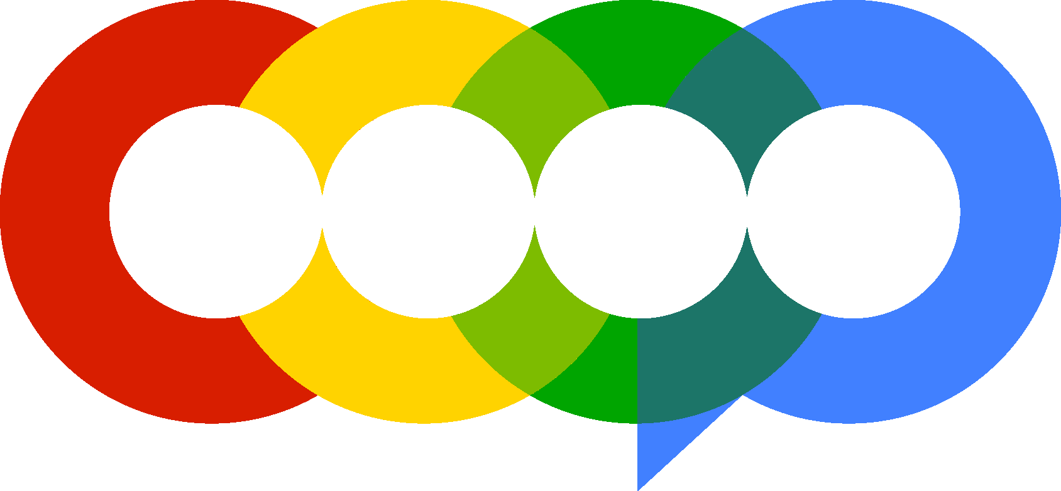
Whole Brain Health Deliverable (Team 2)
Analyzing Youtube and Tiktok data, and doing a comparative analysis on the website against top 2 competitors

Slide 2
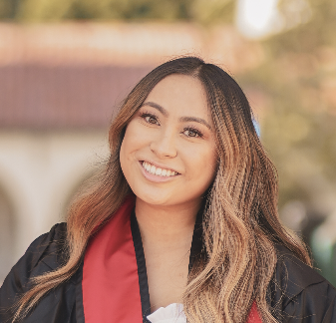

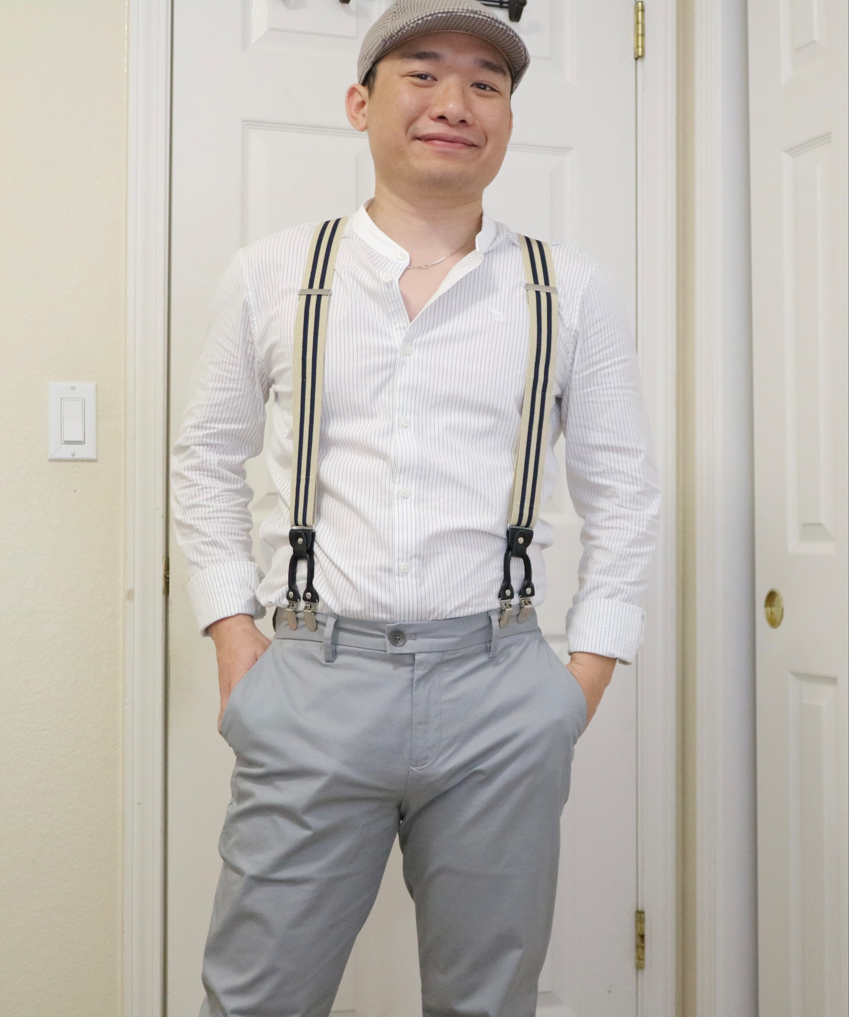




Meet Our Team

Slide 3
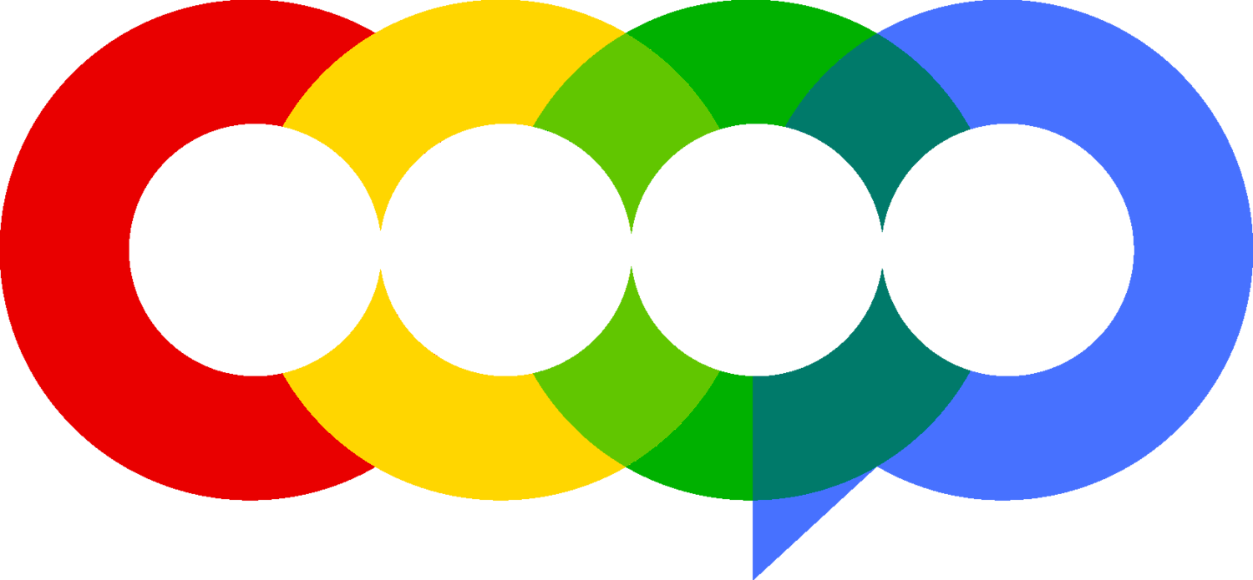
AGENDA

Slide 4
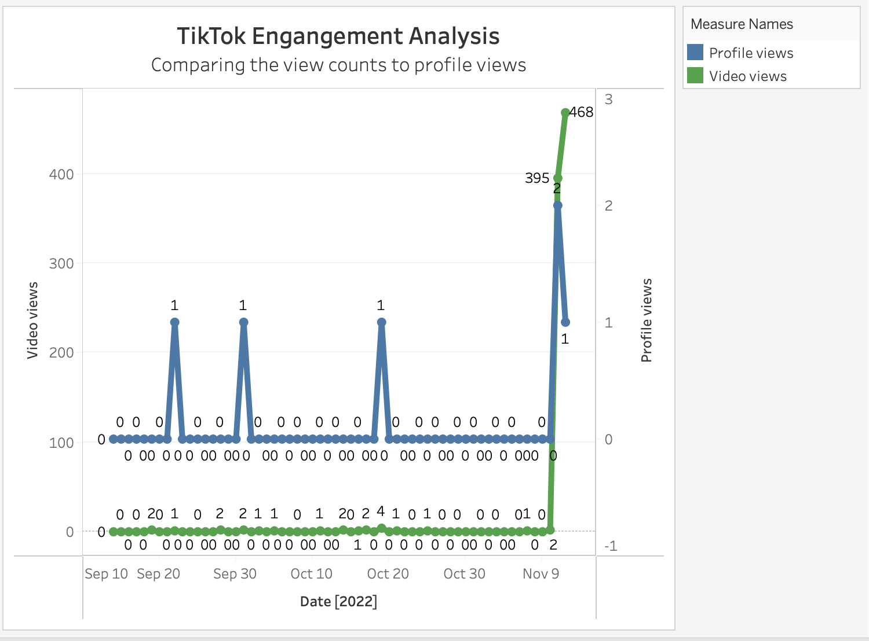
TikTok Analysis
Between Sept. 14th, 2022 - Nov. 12th, 2022
Observations:
With over 300 views on 11/11 and 11/12
Had a total of 5 profile views
Insights:
Engagement was high on TikTok during these days(11/11 and 11/12)
Notes:
Video_views had a total of : 887 views within the ~60 days of data. With over 300 views on 11/11 and 11/12.
With a total of 17 days out of 60 days that received views.
Currently has no video comments on any videos.
A total of 2 video shares. One on 11/11 and 11/12.
Had a total of 5 profile views.
Only two days had likes which were 11/11 with 24 likes and 11/12 with 147 likes. That’s a total of 171 likes.

Slide 5
YouTube Traffic Sources Overview
13 Traffic Sources
Suggested Videos
Direct or unknown
External
Other YouTube features
Browse features
YouTube Search
Channel pages
Playlists
Shorts
Feed
Playlist page
End Screens
Video cards
Annotations
Notifications
Notes:
Between Sept. 1st, 2020 - Nov. 12th, 2022
Observations:
Top views coming from:
Suggested Videos brought in the most traffic
Direct or unknown - 2158
External - 2123
Browse features - 1810
YouTube Search - 1677
Insights:
Suggest Videos on YouTube channel brought in the most traffic
Findings:
Between the time frame of the provided data there was a total of 24,299 views.
Most of their views coming from:
Suggested Videos - 15398
Direct or unknown - 2158
External - 2123
Browse features - 1810
YouTube Search - 1677

Slide 6
YouTube Traffic Sources Overview
11 Traffic Sources
Suggested Videos
Direct or unknown
External
Other YouTube features
Browse features
YouTube Search
Channel pages
Playlists
Shorts
Feed
Playlist page
End Screens
Video cards
Annotations
Notifications
Notes:
Between Sept. 1st, 2020 - Nov. 12th, 2022
Observations:
Top views coming from:
Suggested Videos brought in the most traffic
Direct or unknown - 2158
External - 2123
Browse features - 1810
YouTube Search - 1677
Insights:
Suggest Videos on YouTube channel brought in the most traffic
Findings:
Between the time frame of the provided data there was a total of 24,299 views.
Most of their views coming from:
Suggested Videos - 15398
Direct or unknown - 2158
External - 2123
Browse features - 1810
YouTube Search - 1677

Slide 7
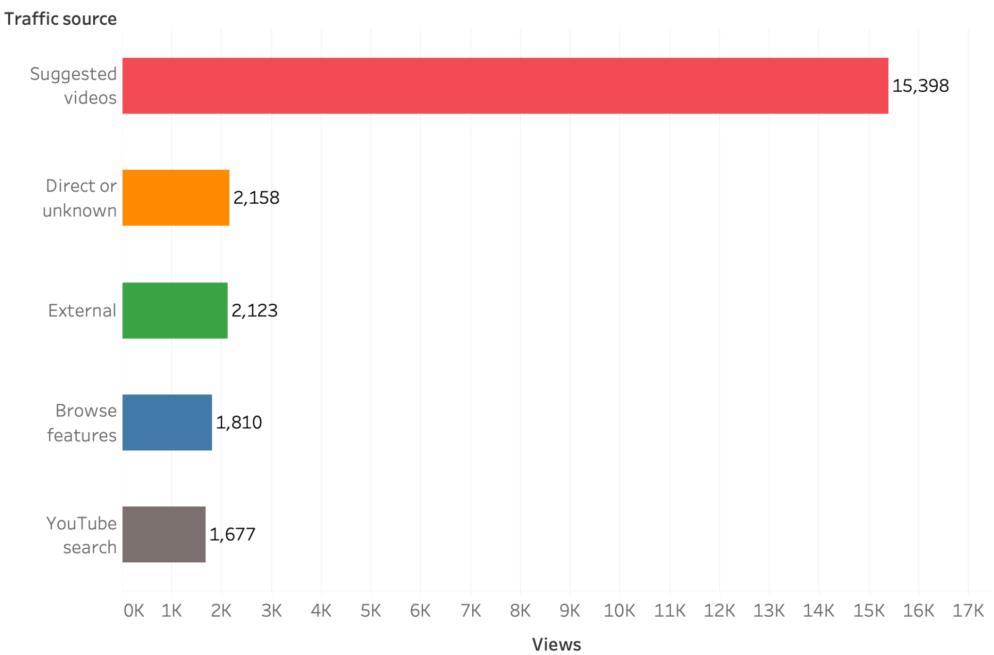
Analysis of Top 5 YouTube Traffic Sources
Between Sept. 1st, 2020 - Nov. 12th, 2022
Observations:
Over 24k views total
Top 5 all have over 1k views
Suggested Videos is #1
63% of views from one traffic source
‹#› • coopcareers.org

Slide 8
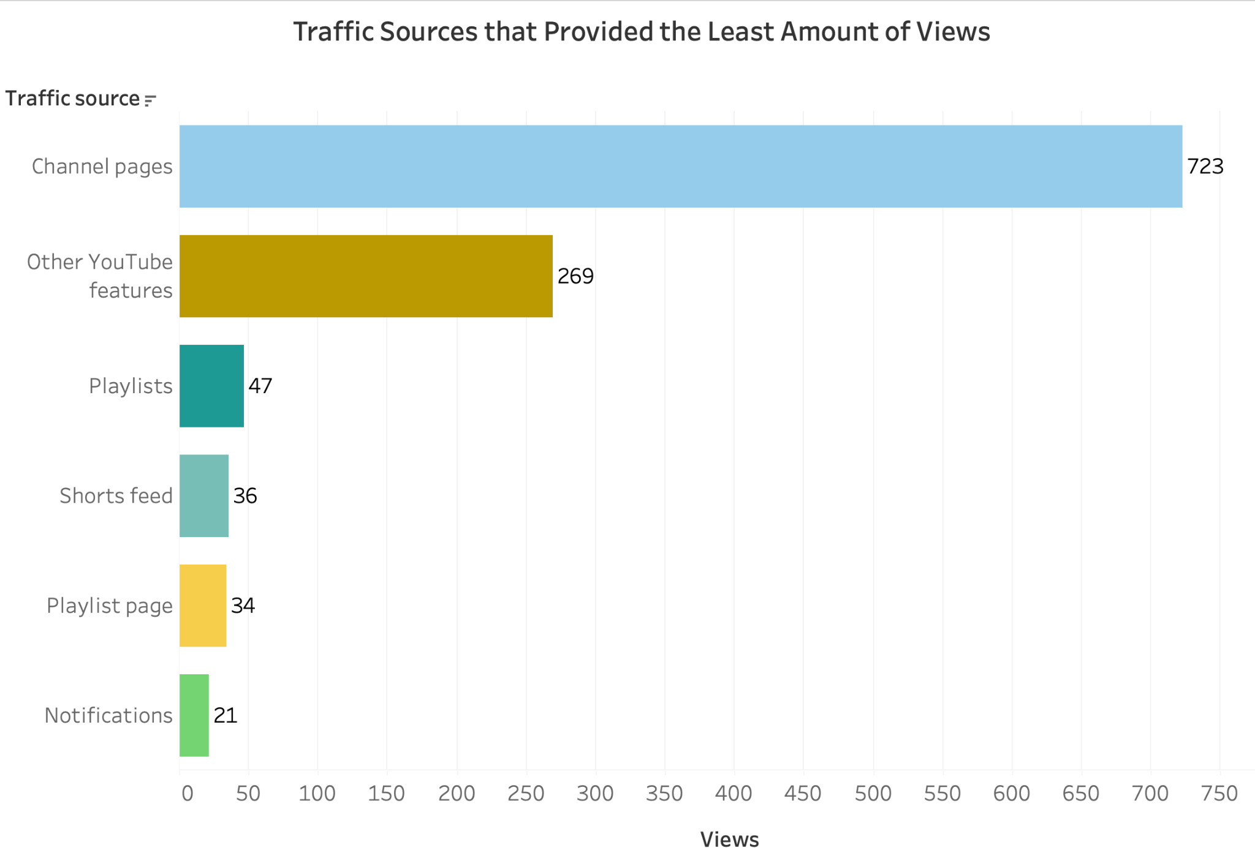
YouTube Traffic Sources with least views
Between Sept. 1st, 2020 - Nov. 12th, 2022
Observations:
Most of the least trafficked sources received under 50 views
Channel pages accounting for 3% of views
Other YouTube features bringing in 1%
Notes:
The least amount of their views came from:
Video cards and annotations - 1
End Screens - 2
Notifications - 21
Playlist page - 34
Shorts feed - 36
Playlists - 47
With a slightly higher increase in:
Channel pages - 723
Other YouTube features - 269

Slide 9
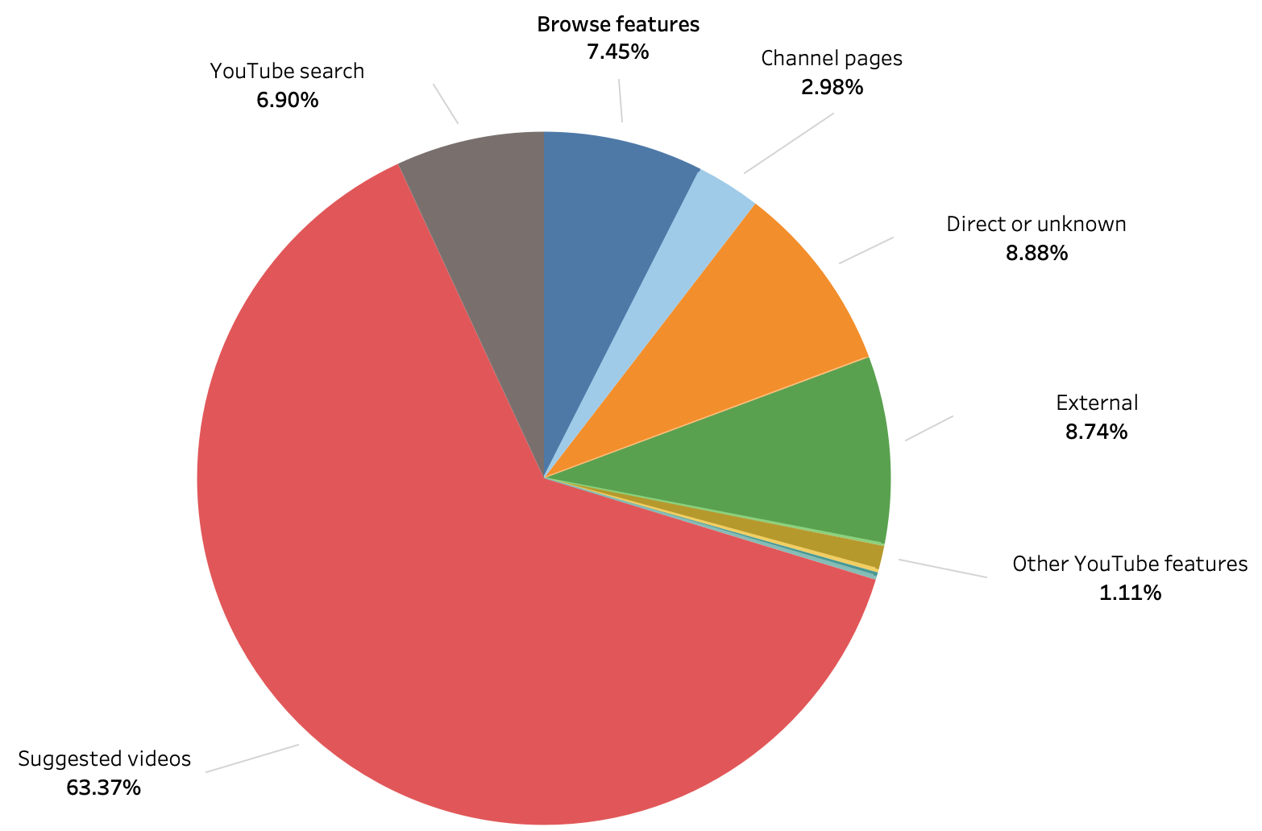
Percentage of Traffic Sources for YouTube Views
**Sources with less than 1% are not labeled

Slide 10
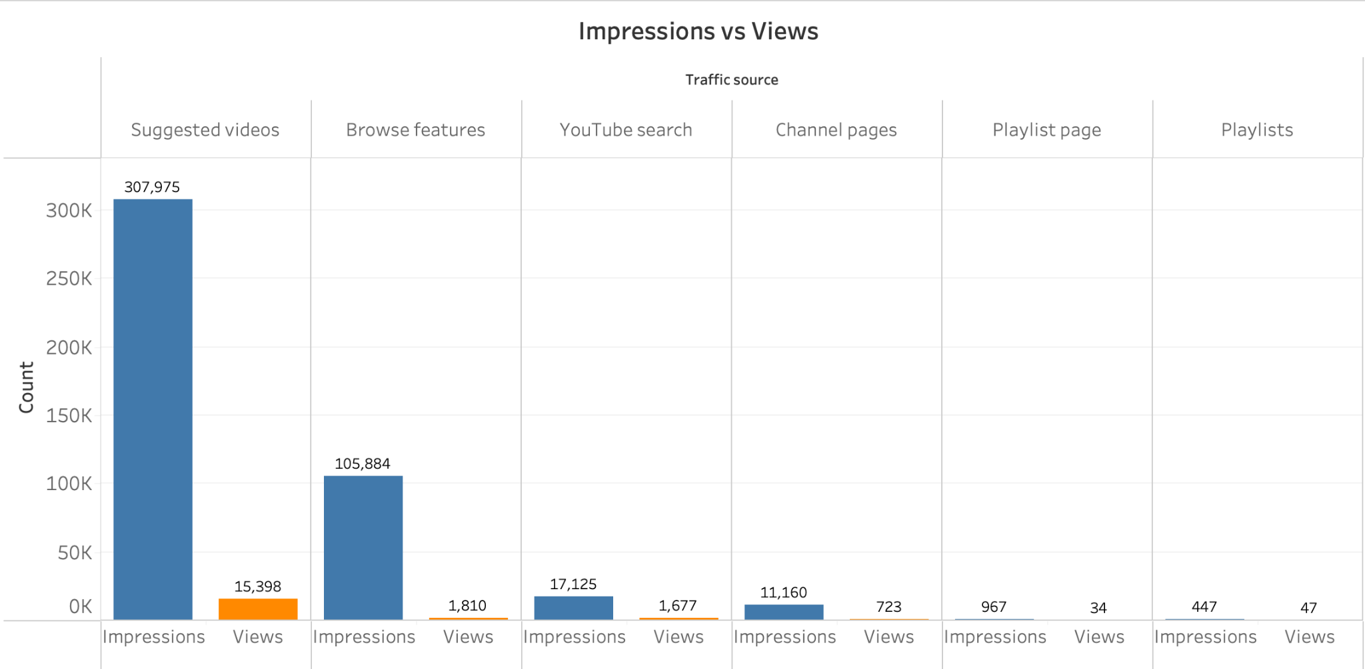
YouTube’s Impressions vs Views
With Impressions in descending order

Slide 11
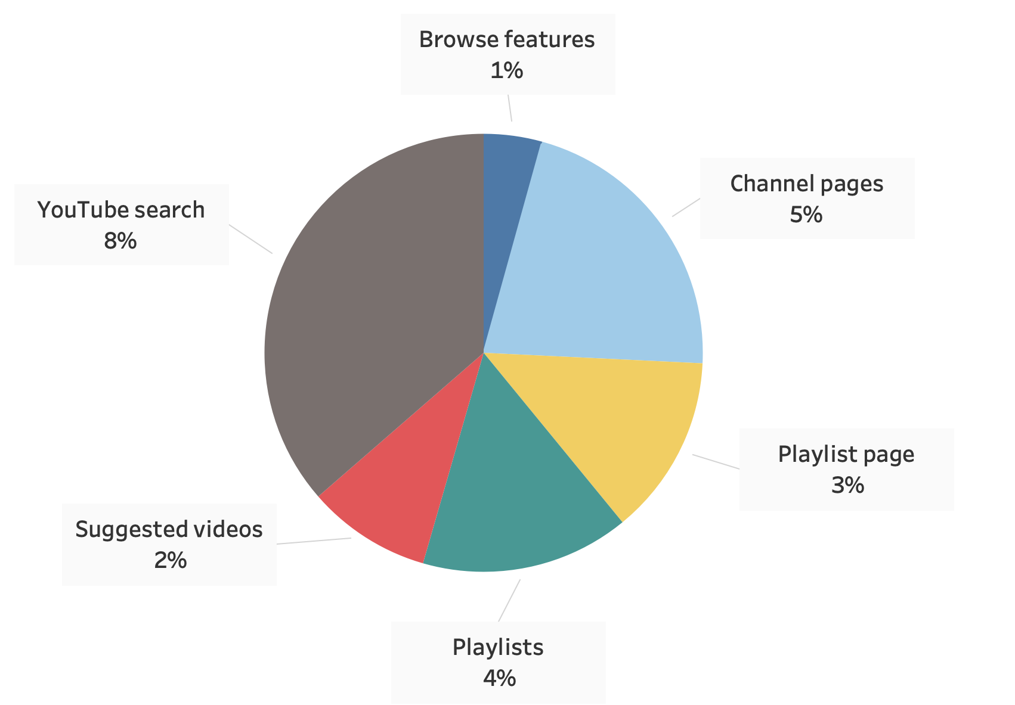
Percentage of YouTube’s Click-Through Rate
**With rounded up percentage values.
Observations:
YouTube search had the highest click-through rate
Browse features had the least
Suggested Videos has a 2% click-through rate, a good average

Slide 12
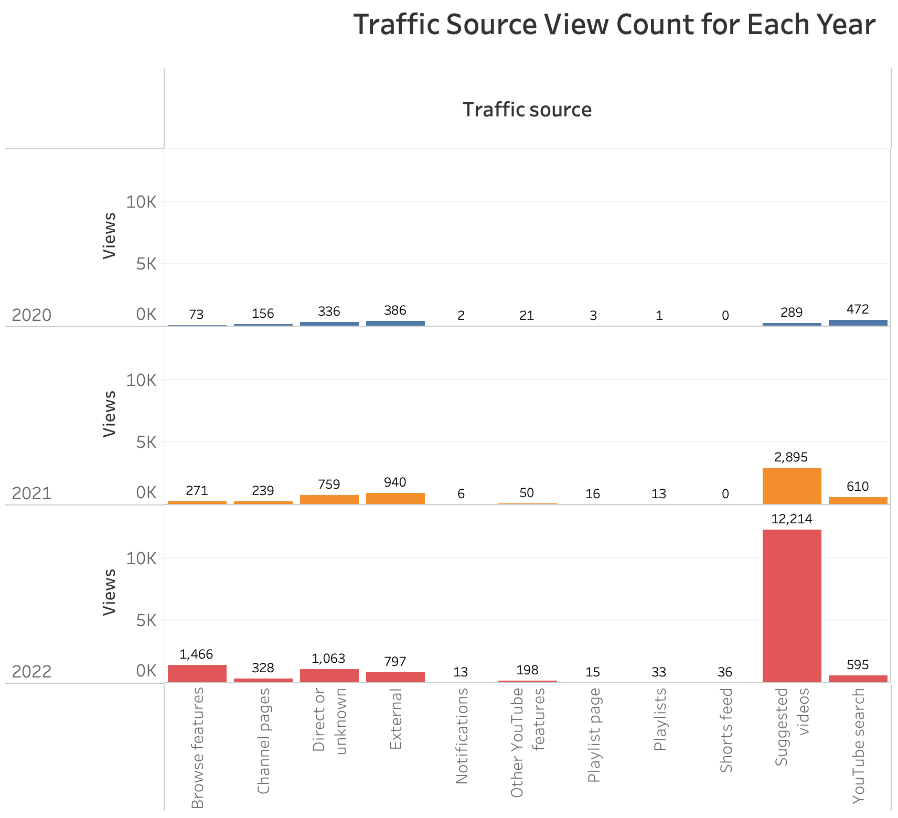
YouTube’s Yearly Views for each Traffic Source
** Total count of views for each Traffic Source per year (2020 - 2022)
Observations:
2022, Short Feeds makes its debut
300% increase in Suggested Videos since 2021

Slide 13
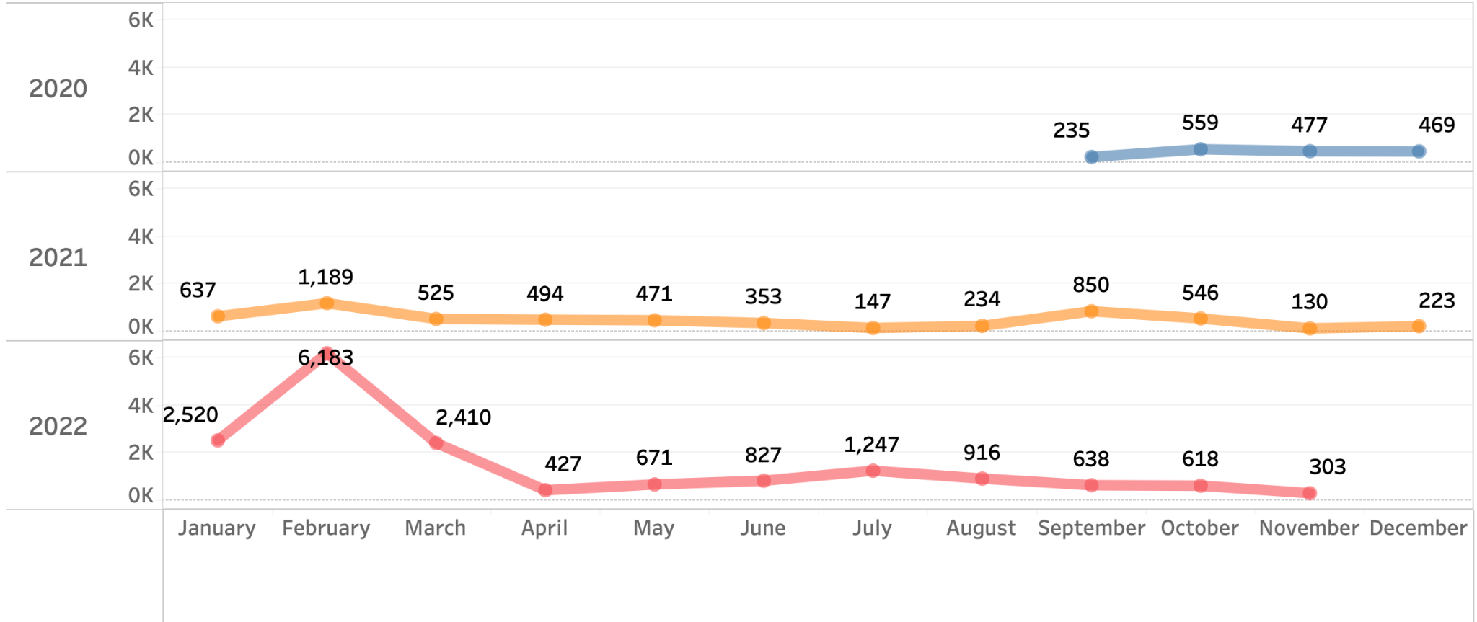
YouTube Total Monthly Views for Each Year

Slide 14
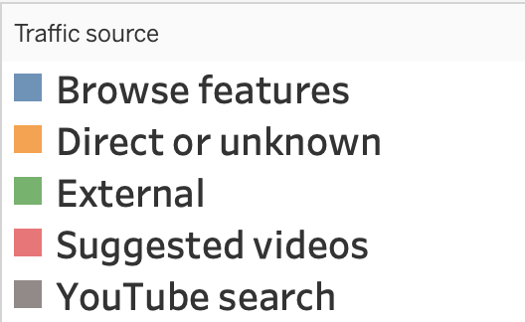
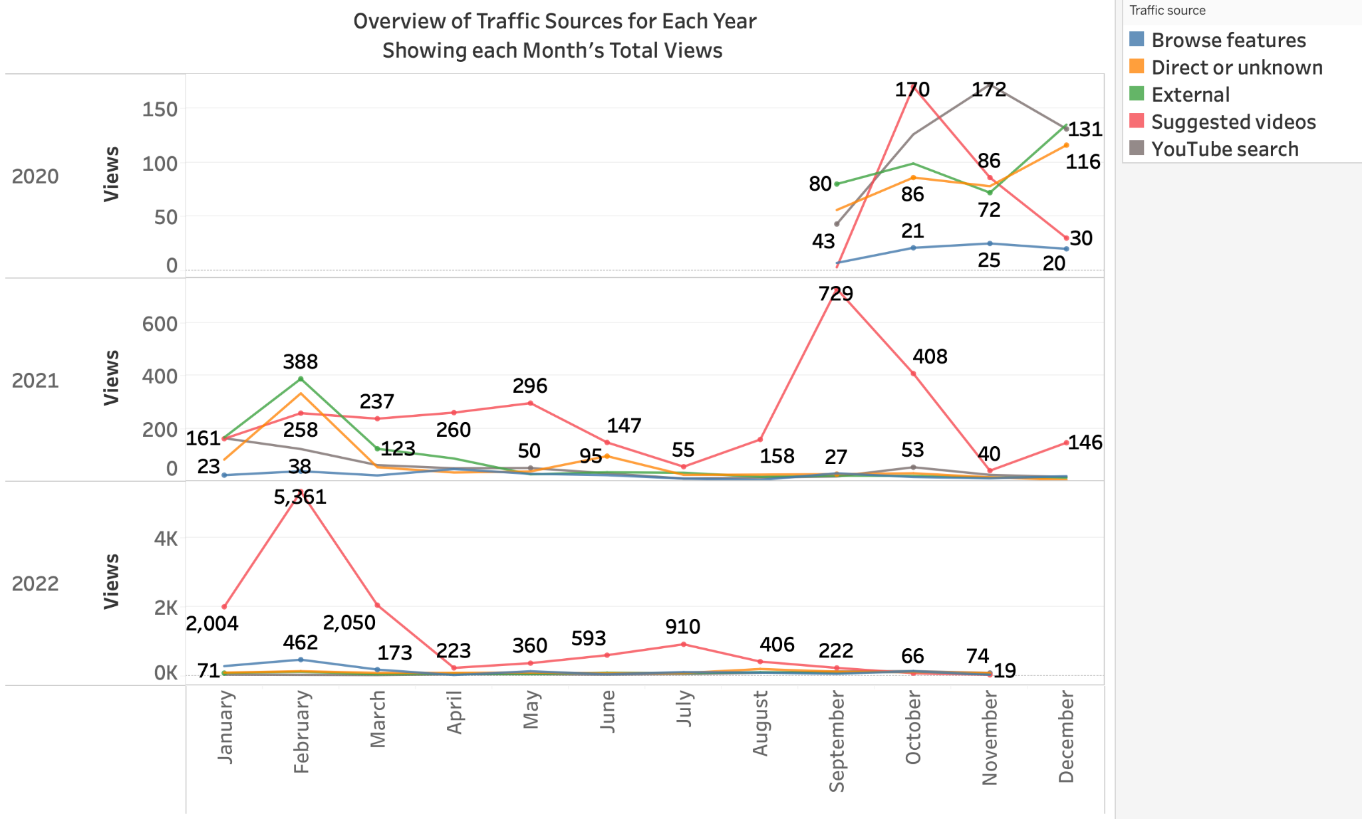
Monthly Total Views for Each Traffic Source per Year

Slide 15
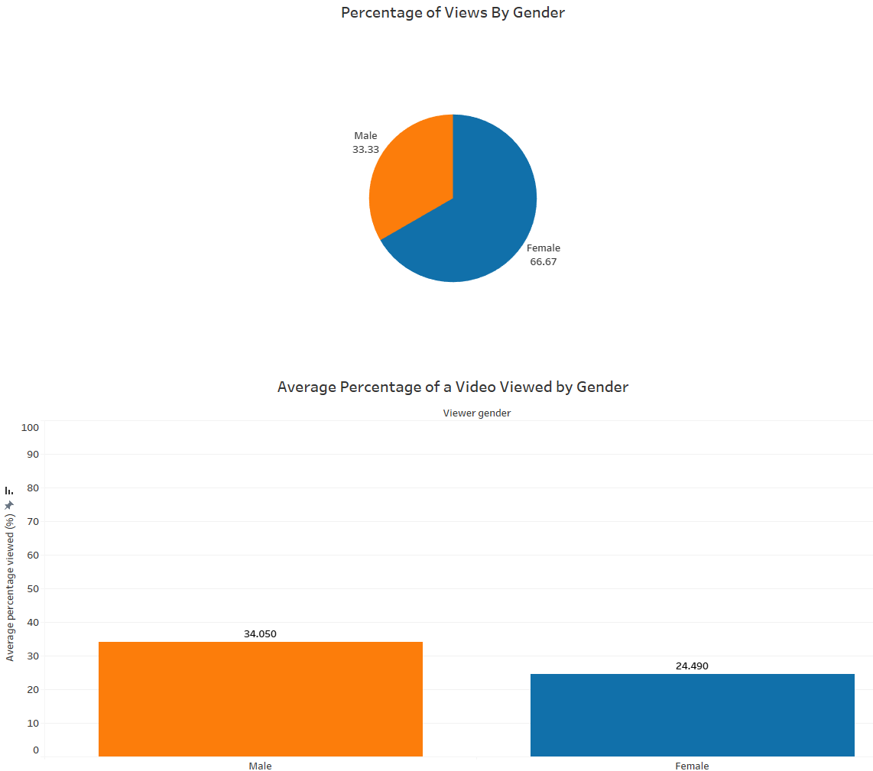
Channel: Gender Demographics
Observations:
2/3 of viewers are female
On average, males spend 10% more time watching a video
Insights:
Females are more likely to watch because they are more likely to have Alzheimer’s because they generally:
live longer than males
have a stronger immune system
Slightly more amyloid plaque
Amyloid plaque plays a central role in causing Alzheimer’s
Possibly some content is more male friendly
Notes:
Jackie

Slide 16
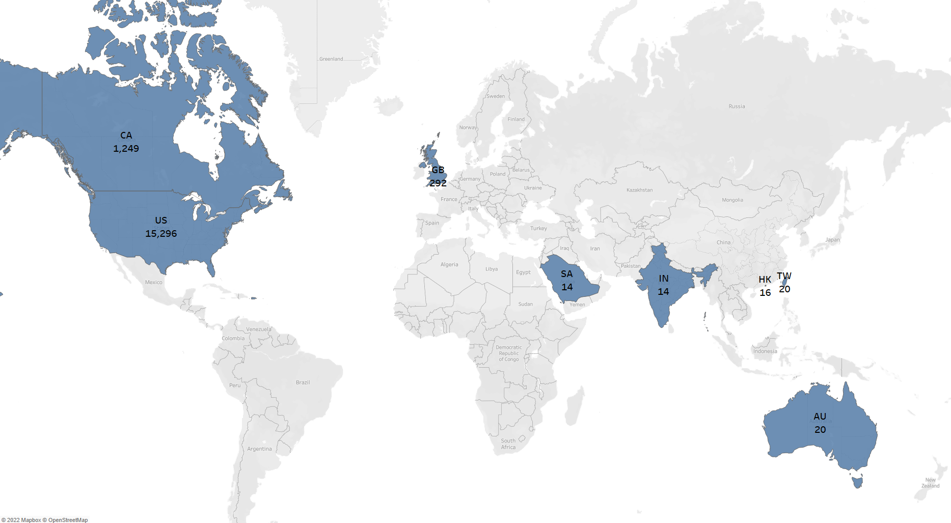
Where Are the Viewers Located?
Observations:
More than half of the views (out of 24,299) are from the US
Second highest amount of viewers come from Canada
Most countries with viewers have English as official language
Insights:
Easier to find and understand the videos for English speakers
Much higher chance of being recommended to English speakers (same language)
Notes:
Jackie

Slide 17
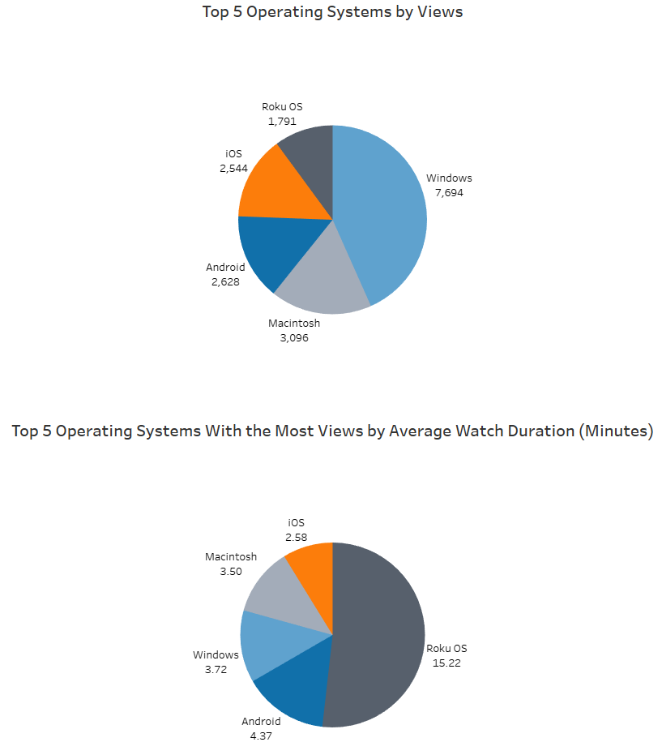
What Operating Systems Do Viewers Use?
Observations:
Majority of viewers are on Windows
Viewers are also watching on smartphones and TV (Roku OS)
Viewers on average watch longer on TV than the other 4 combined
Insights:
Seniors spend more time on the TV than other operating systems
Easier for seniors to follow along with the exercises when watching on a bigger screen
Videos on TV starts in fullscreen (less distractions from UI / recommendations)
Easier to search videos, find and click on recommendations on computers and phones
Notes:
Jackie

Slide 18
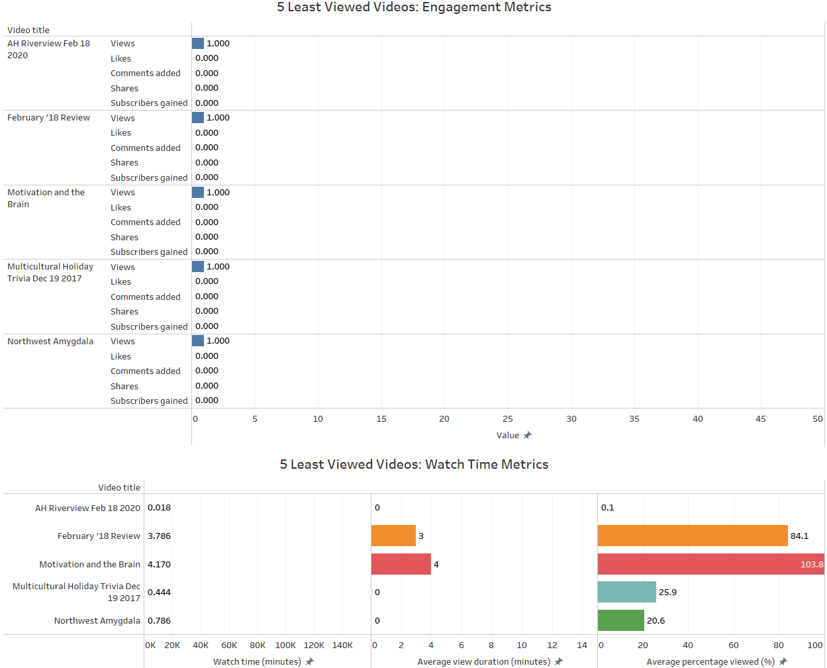
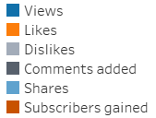
Youtube Search / Recommendation Algorithm
Observations:
The 5 least watched videos have little to no:
Engagement
Likes, Comments, Shares, Subscription
Watch Time
Low average view duration and percentage viewed
Random videos, not Fitness Trivia
Insights:
Videos with little to no engagement and watch time -> lower algorithm rankings compared to similar videos
The content of these videos are most likely not popular with target audience and are hard for viewers to find
Notes:
Jackie

Slide 19
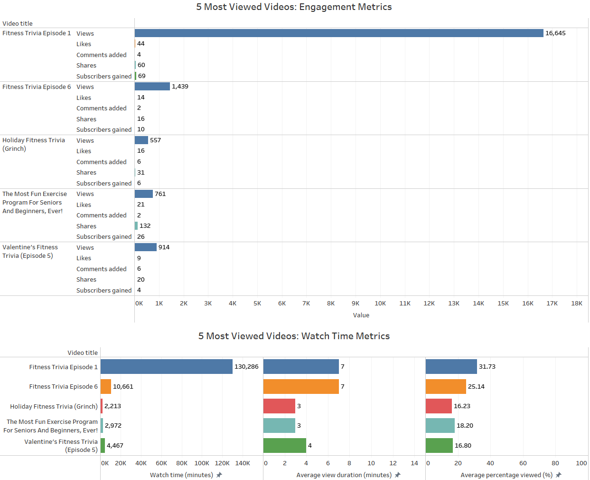
Observations:
The 5 most watched videos have:
Engagement
Likes, Comments, Shares, Subscription
Watch Time
Low average view duration and percentage viewed
They are all Fitness Trivia videos
Insights:
Higher view count have higher potential engagement/watch time -> Higher algorithm rankings
Fitness Trivia episodes are the most popular among viewers
Videos are not holding viewer attention
Viewers are not engaged -> bounce
Notes:
Jackie

Slide 20
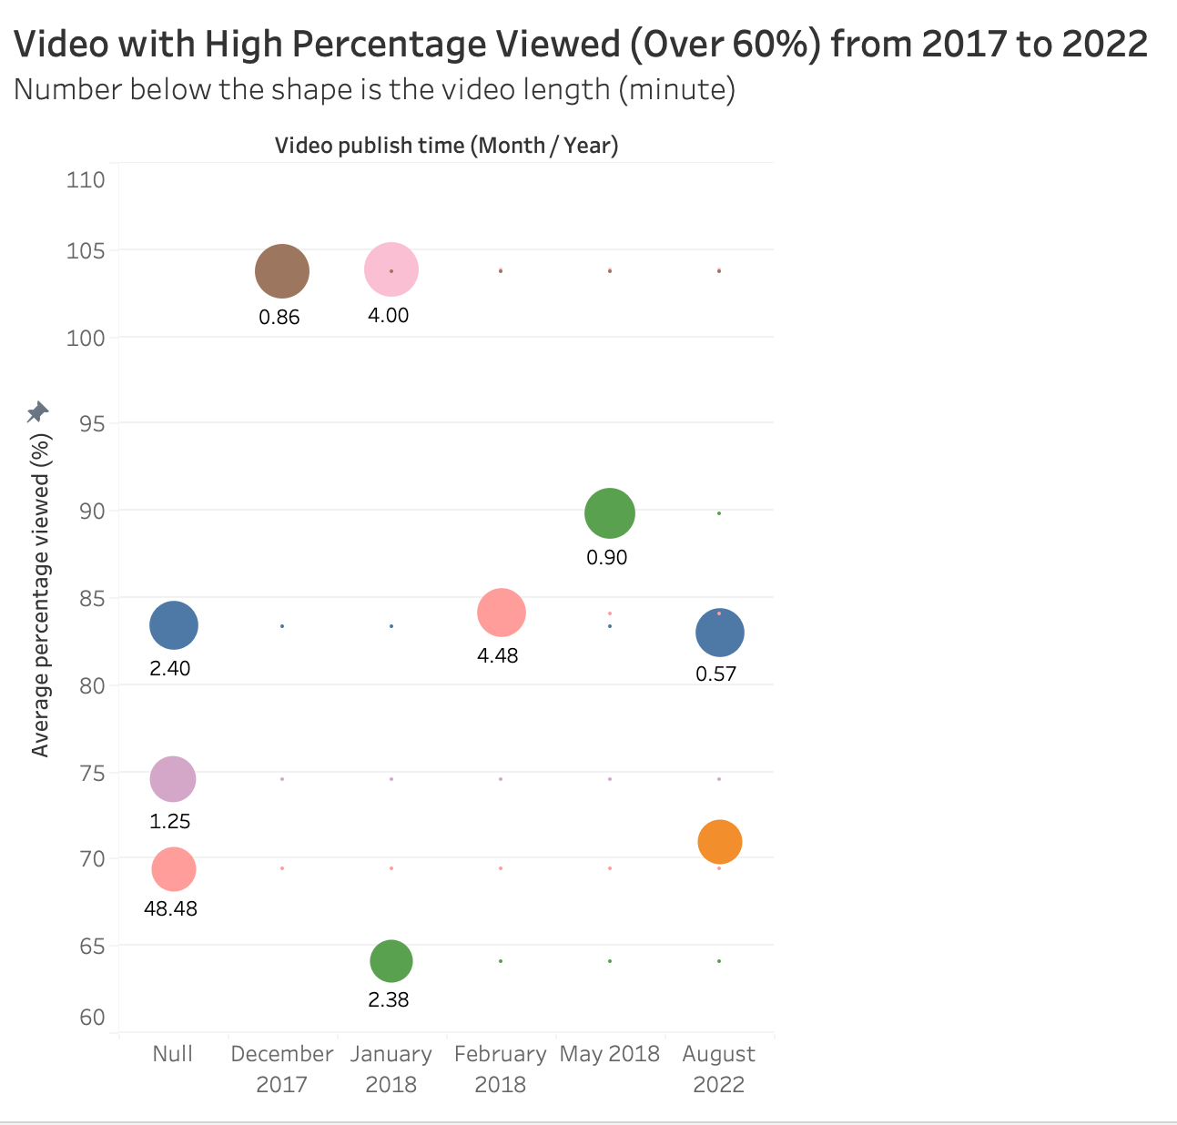
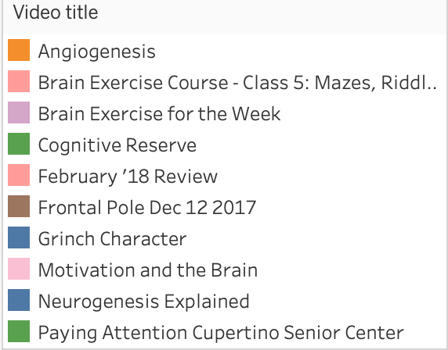
Video with High Percentage View
Observations:
In 2017, Frontal Pole Dec 12, 2017 (109%).
In 2018, Motivation and the Brain (103.84%).
In 2022, Neurogenesis Explained (83.1%).
Unlisted Videos have a high percentage view (Grind Character - 83.34%).
Insights:
Most videos with high percentage views are videos in short time (Less than 4 minutes).
With short videos, the viewer watches the videos again. It leads to high average view duration and high percentage view.
The viewer is curious about how the brain works.
Notes:
For example: There are 2 videos about neurogenesis: Neurogenesis explained by Dr. Cain (35 seconds) or Frontal Pole Dec 12 2017 (52 seconds) and another illustration neurogenesis (37 seconds). But video about neurogenesis explained has more views than the illustration neurogenesis. The audience would like to know how the brain works and the explanation from Dr. Cain.

Slide 21
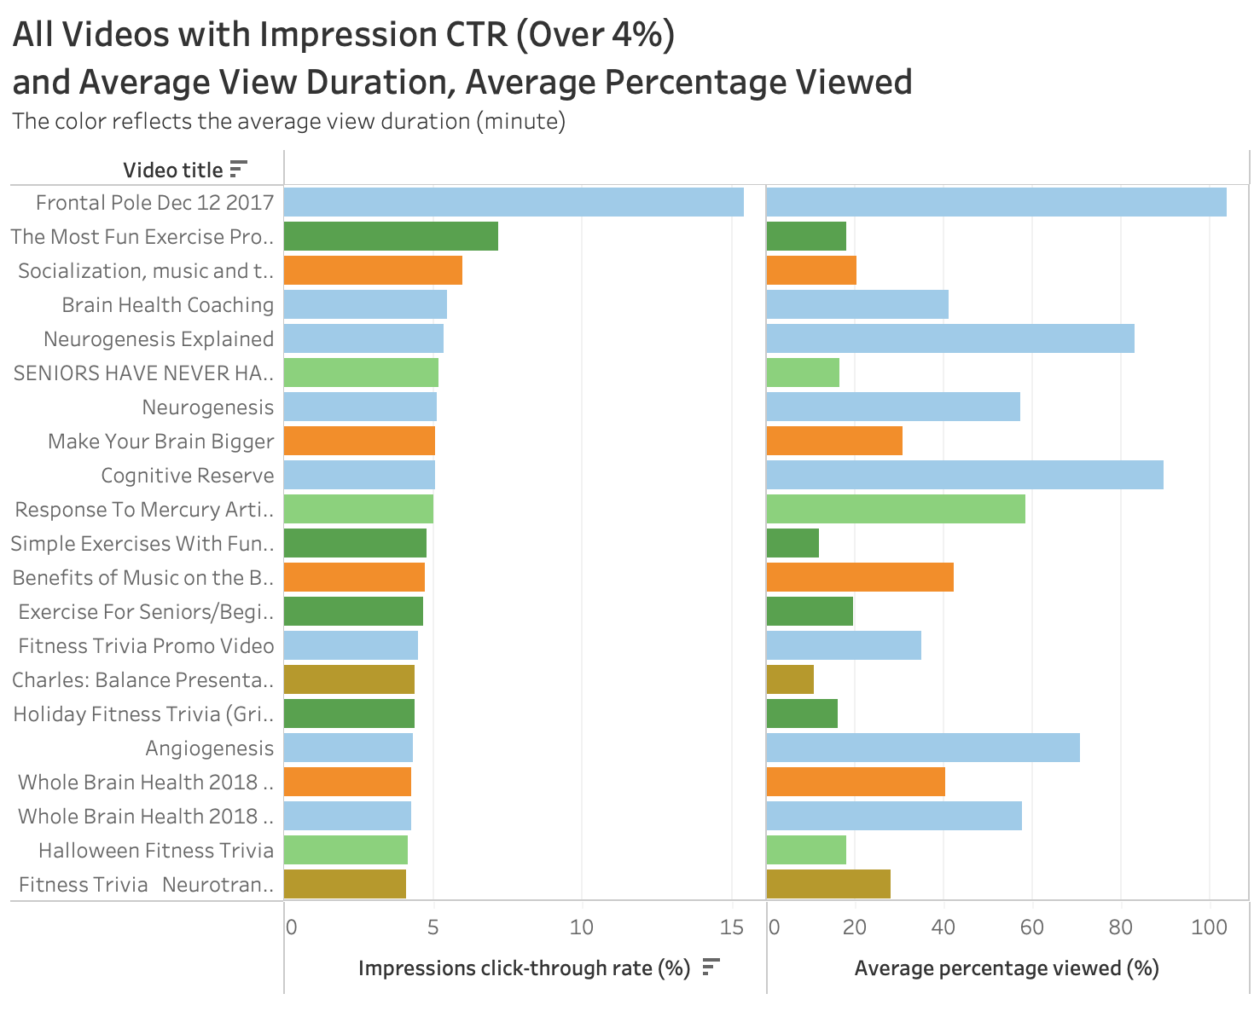
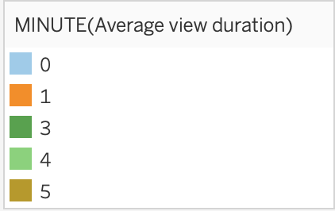
Observations:
Most videos which have average view duration less than 3 minutes have high average percentage viewed and Impression CTR.
Frontal Pole Dec 12 2017, engage viewers the most with 0 min average view duration.
Fitness Trivia Neurotran..
Videos have average percentage viewed over 50% when the average duration is less than 1 minute.
Videos have high average view duration when average percentage viewed is low => high bounce rate, not engage viewers.
Insights:
Short length videos and shorts are good. It engages viewer to watch. When average percentage viewed is high, Youtube will recommend the videos on network.
Depending on the target audience, videos will engage viewers by the title, thumbnails, content. Those things will increase the curiosity rate and increase the impression CTR.
Notes:
Half of all channel and videos on Youtube have CTR between 2% and 10%, so low ctr doesn’t necessarily mean bad
https://support.google.com/youtube/answer/7628154?hl=en#zippy=%2Chow-do-i-know-if-my-impressions-click-through-rate-is-high-or-low

Slide 22
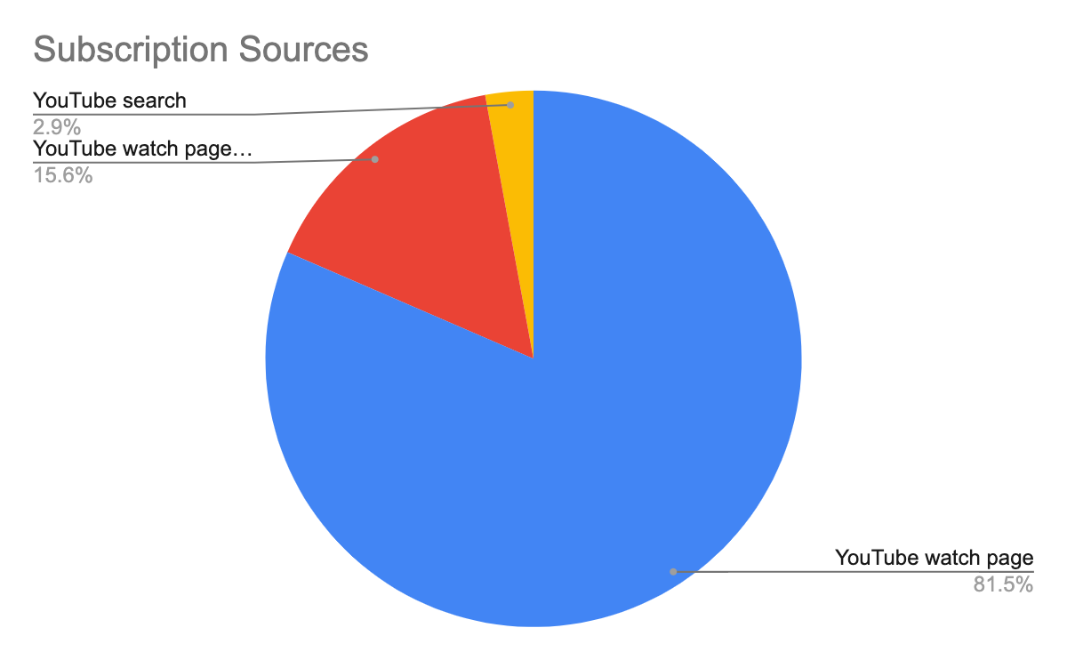
Where are you gaining YouTube subscribers?
Observations:
Over 80% of subscribers subscribed from the YouTube Watch page (the video’s specific page)
The rest came from your YouTube channel and through searching directly for the business
You gained most of your subscribers from your videos!
Insights:
Subscribers make up around 4% of total viewers
1,061 of 24,299 total views come from subscribers
Seemingly loyal subscribers
They are watching your videos!
Each subscriber adds 6 views on average to your total view count
Notes:
Marissa
Viewers and subscribers will increase together. Your viewers seem to be watching your videos as each sub adds 6 viewers to your total view count.
Encouraging audience to comment and subscribe would be a rlly good idea. Get those 24K not subscribed to engage.
Data we had shows 1061 viewers were subscribers of 24,299 total viewers = 4.37%.
What videos gained the most subscribers
Fitness Trivia Episode 1, The Most Fun Exercise Program For Seniors And Beginners, Ever!, and Fitness Trivia Episode 6 Had the most subscribers gained.
Mimicking the content of the most popular videos for future videos can be strategic for increasing views and engagement on your page
Look more into the actual content to see what is working

Slide 23
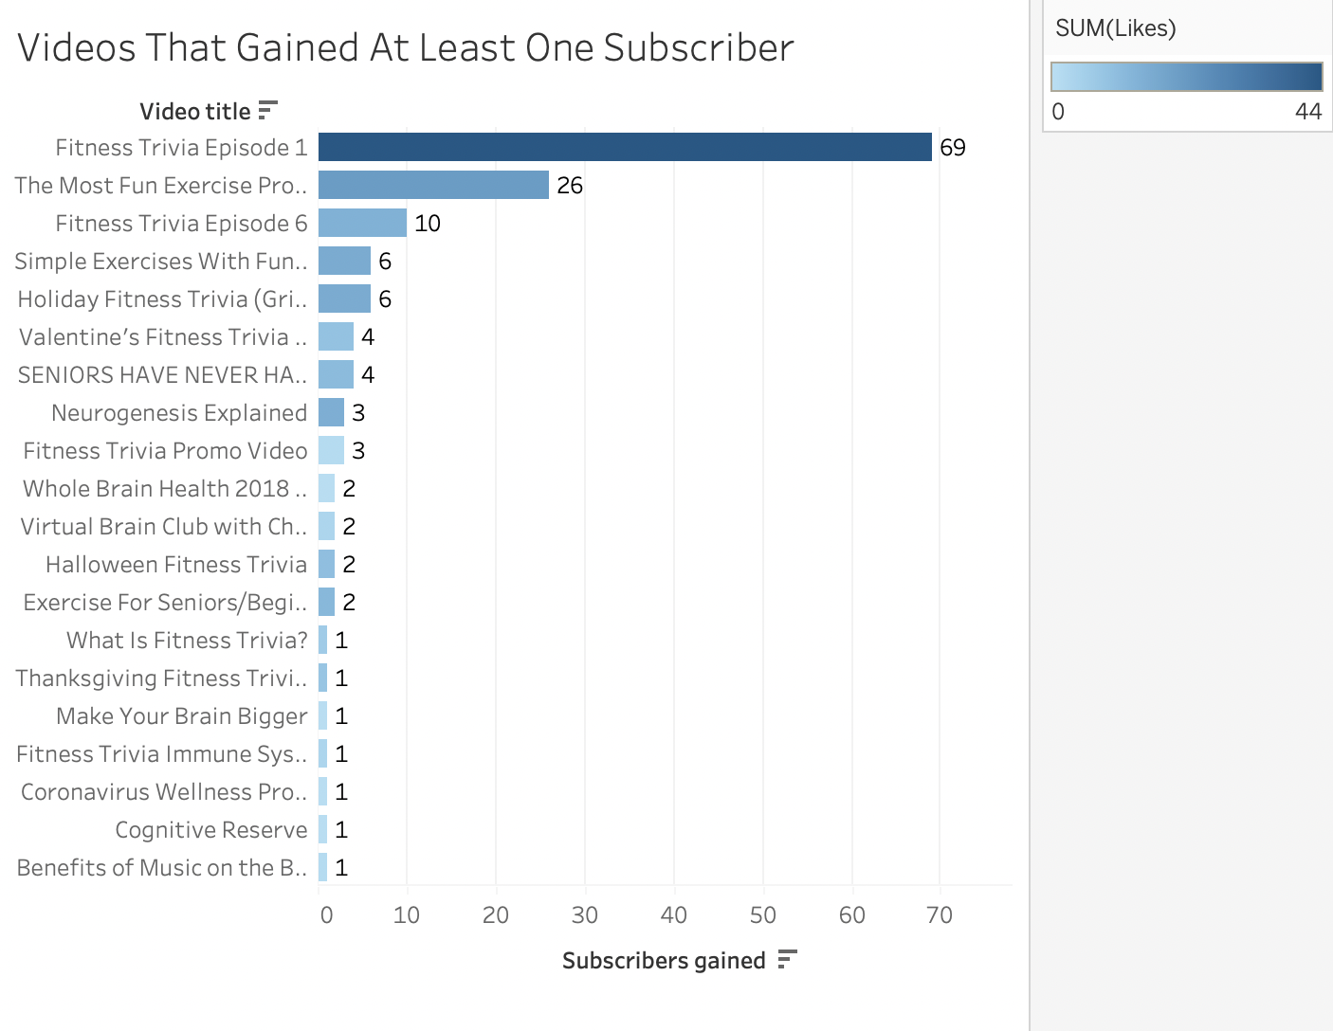
Which videos gained subscribers?
Observations:
Holiday videos do really well! They have highest amounts of both views and subscribers
Fitness Trivia Episode 1 and 6 are the most popular and have gained the most subscribers
Insights:
Views, likes, and subscriptions grow together
Think of this as a numbers game and keep up your favored content style to grow your channel
Good idea to look into why Fitness Trivia Episode 1 and 6 did so well
How did you promote these videos?
What did you include in these videos that make them stand out?
Notes:
Marissa

Slide 24
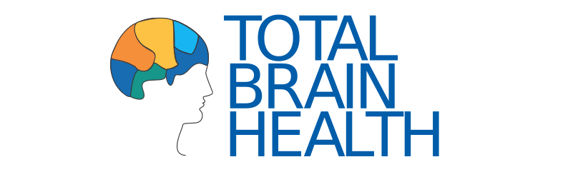
Competitor #1: Total Brain Health
Pros:
Nice images
Portrays a friendly, fun, welcoming environment that caters to seniors
Free article when you input your email
Shows upcoming events + link to register on top bar as you scroll
Quotes from participants about their liking towards the program
Shows their health partners
Offers a toolbox with flashcards, dice, and a timer, and other toolkits online and physically
Facebook, Instagram, Twitter, YouTube links
Free newsletter
Cons:
Website is one long page and has top index header lines to take you to part in the page where that info is presented
Toolkits are very expensive (~$600 annually)
Notes:
Ashley can finish this!

Slide 25

Competitor #2: HASfit
Pros:
Varying programs focused on different goals along with explanations of the benefits of each program
Shop that sells brand apparel, monthly workout plans, books, and DVDs
Dietary recipes and food inspirations
Mobile App accessible
Option to give a one-time donation or membership subscription
Fitness calculator, health articles, vlongs
Offers additional services such as personal training
Cons:
Difficult to navigate website due to an abundant of redirecting drop down menus and headers
Too many options could make it difficult to find what the audience is looking for
The call to action is not explicit especially since the website contains a lot of information
Overall very jam-packed website with a ton of information
Notes:
Jason

Slide 26

Whole Brain Health
Pros:
Has call to action feature on landing page
Offers 1 to 1 coaching
Offers virtual classes
Has online course
Has fitness trivia
Has a blog
Landing page is not too cluttered and aesthetically pleasing
Clearly shows what is offered (Virtual brain fitness class, fitness trivia, 1:1 brain health coaching)
Cons:
Does not include YouTube icon with the rest of social media links above navigation bar
When clicking on the link (About Us and Services) in Navbar, does not link to anywhere. A click on the list items under Navbar link is needed in order to transition to another page, however Navbar link is treated as a button and is clickable.
No email address offered as an option of communication/ or option to send a message. Only sign up for email updates.
Notes:
What makes client unique

Slide 27
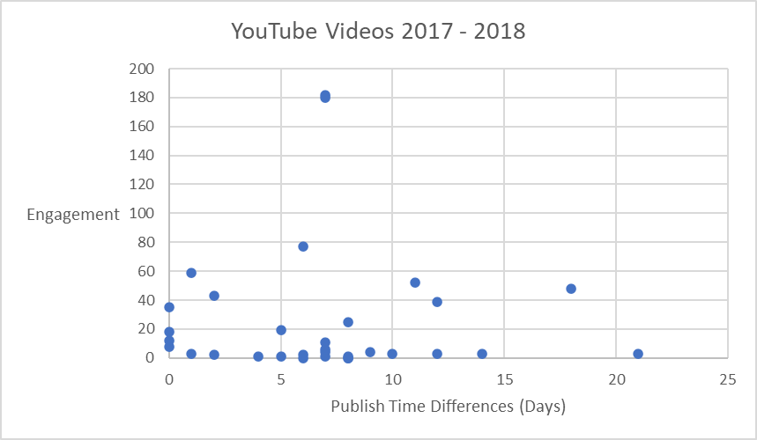
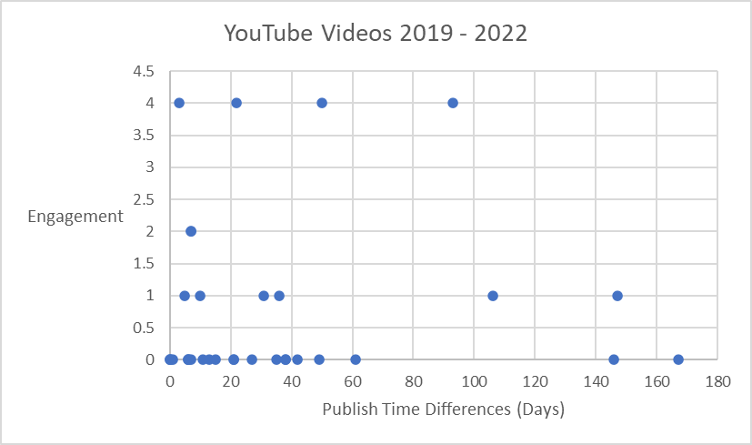
Publish time vs Engagement

Slide 28
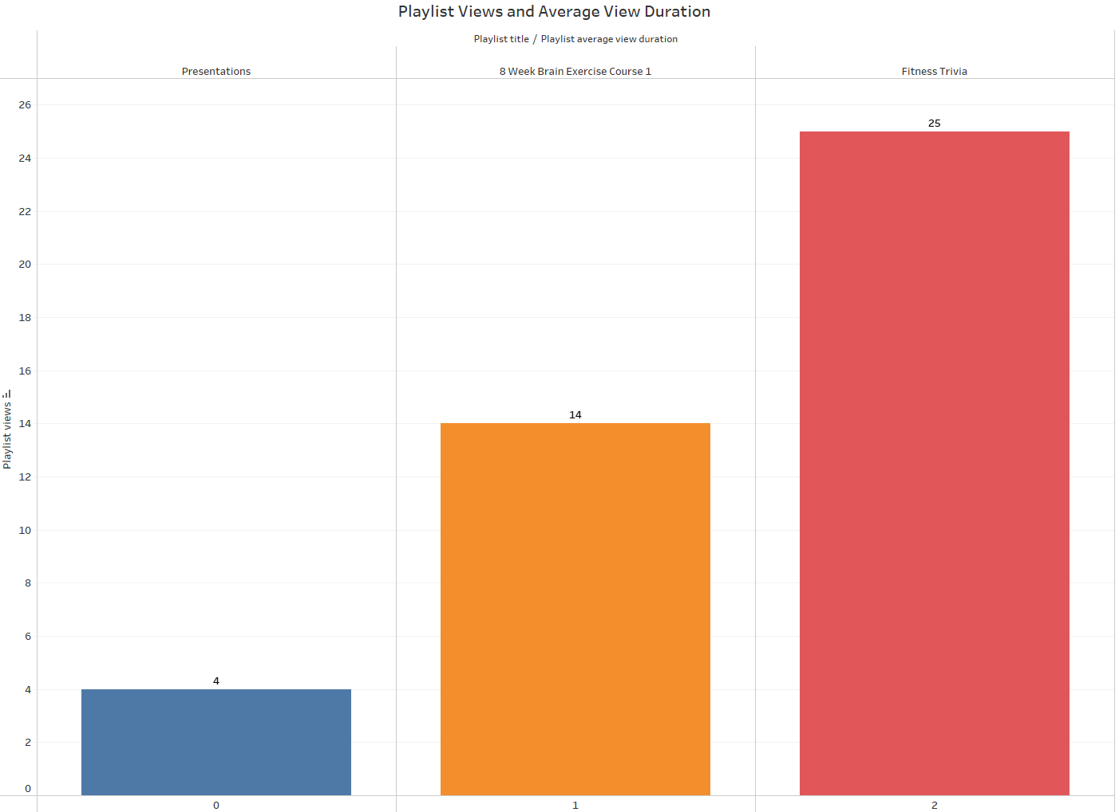
Playlists
Observations:
Playlists have:
Low view count
Low average view duration (minutes)
Fitness Trivia is the most popular topic
Insights:
Inaccurate or unintriguing titles and thumbnails
Videos inside playlist is unorganized or irrelevant to playlist topic
Notes:
Playlists are good way to organize similar videos.Helps viewers easily consume favorite topics and prompts them to keep watching which helps with watch time metrics.
Recommendation: Organize playlist with accurate but intriguing titles and thumbnails. (Possibly promote/add playlist in regular videos)

Slide 29
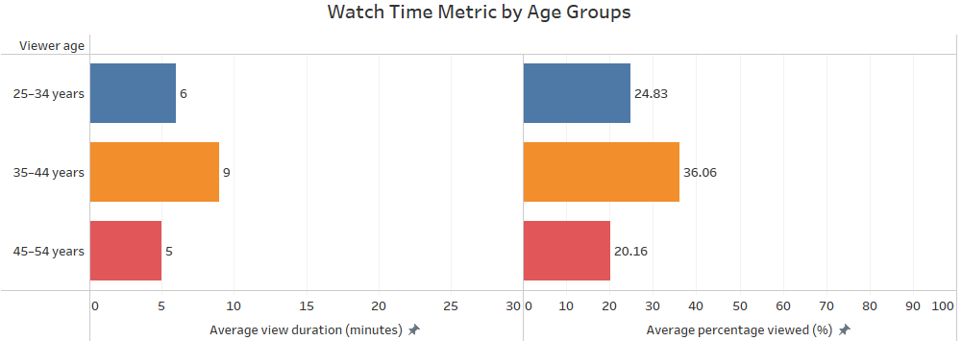
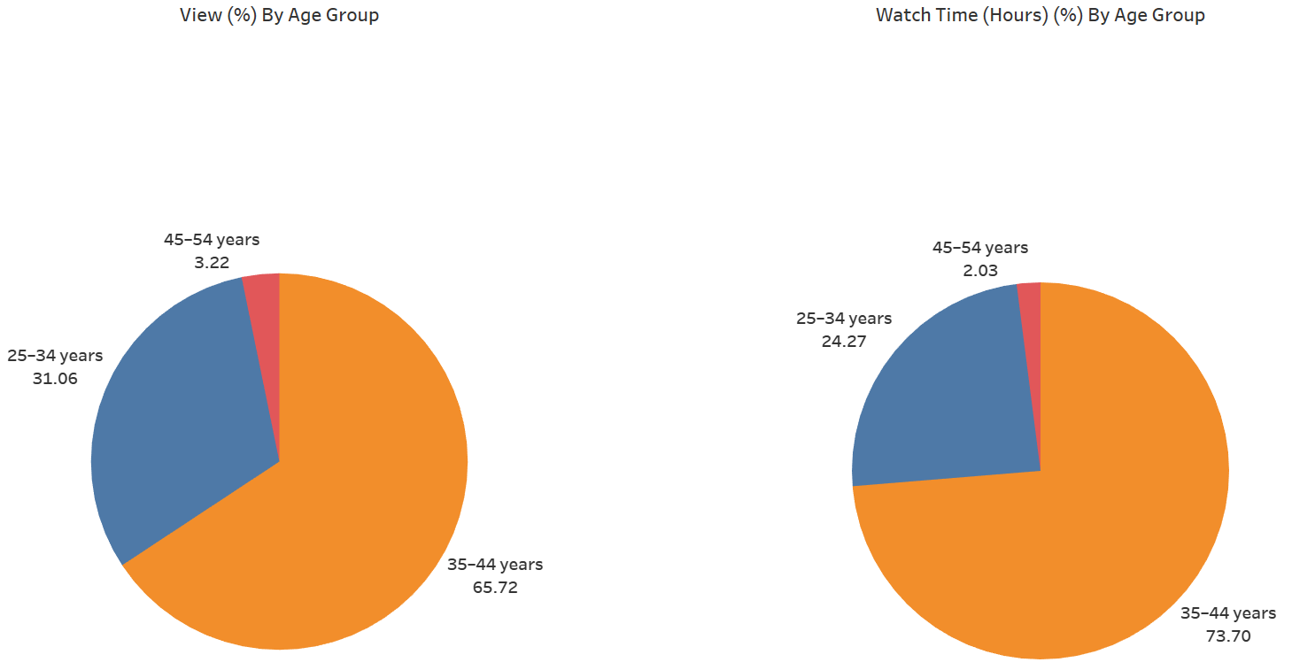
Channel: Age Demographics
Observations:
Viewers that are 35-44 years old have the highest average view duration and percentage viewed
Ages 25-34 have higher watch time metrics than 45-54
Majority of viewers are aged 35-44 followed by 25-34
¾ of total channel watch time are from viewers who are 35-44 followed by 25-34
Viewers are younger than the intended target audience
Insights:
Younger generation watches Youtube more often
Notes:
Recommendation: make content that is suitable for younger generation (25-44) that is also helpful for seniors (intended target audience), i.e. Shorts, fun and intriguing/engaging videos

Slide 30

Comparative Analysis – Website Observations
Our Client: Whole Brain Health
Top Competitors: Total Brain Health, HasFit
Clear display of services offered:
Fitness Trivia
1:1 Brain Health Coaching
Virtual Brain Fitness Class
Header indexes redirect to a different page
States explicit goals that the audience can hope to expect
Clean and easy to navigate website
Products are sold on Amazon which caters to users who prefer Amazon
Visually very similar to Whole Brain Health with the header and page layout
Website is one long page and has top index header lines to take you to part in the page where that info is presented
Shows upcoming events + link to register on top bar as you scroll
Quotes from participants about their liking towards the program
Shows their health partners
Offers a toolbox with flashcards, dice, and a timer, and other toolkits online and physically
Toolkits are very expensive (~$600 annually)
Visuals are relatively different from Whole Brain Health and Total Brain Health
Abundance of redirecting drop down menus and headers can cause difficulty navigating
Visuals consists of athletic youth and no seniors
Overall a very jam-packed website with a ton of information
Varying programs focused on different goals along with explanations of the benefits of each program
Freemium model offering free and paid programs that costs roughly $10 one time
Fitness calculator, health articles, vlongs
Offers additional services such as personal training
Notes:
Ashley/Jason(I can present this slide or a part of it at least - Jason)

Slide 31
Conclusions
TikTok
Tiktok had 887 views within the ~60 days of data. With over 300 views on 11/11 and 11/12.
YouTube
Majority of Youtube’s traffic engagement comes from “Suggested Videos
2/3 of Youtube Channel viewers are female. On average males watch the videos for a longer time
Audience prefers shorter length videos
More than half of the views (out of 24,299) are from the US
Favorited operating system for viewing videos is Windows PC
Fitness Trivia videos have highest view count and engagement
Website

Slide 32


Youtube Recommendations
Increasing Youtube Algorithm metrics
Asking viewers to like, comment, share, and subscribe so videos gain engagement and is more likely to be recommended
Provide videos with subtitles or voice over in other languages
Consider content that caters to viewers who watch on smaller screens (smartphones, computers) as well as big screens (TVs)
Consider videos on how the brain works by explaining in a short time (less than 4 minutes)
Content that holds viewer attention and engages with viewers
Improve playlist titles and thumbnails
Organize playlist videos
Most interesting / chronological order on top
Same topic
make content that is suitable for younger generation (25-44) that is also helpful for seniors (intended target audience), i.e. Shorts, fun and intriguing/engaging videos

Slide 33

TikTok Recommendations
Post more videos
Aim for 5x/ week
Can plan out certain amount of content to post automatically when desired (ex. Plan month’s content and upload it at beginning of month to post once a day Monday-Friday)
Invest in paid partnerships with TikTok influencers
Find good ambassadors
Use popular hashtags (ex: #FYP)
Utilize the Q&A feature
Curate your page’s aesthetic
Make the thumbnail photos nice and engaging so it makes people want to click your videos
Include Call-to-Action’s in your posts
Make videos giving a rundown of your program and pin them to your profile if they do well
Participate in TikTok Live at a scheduled time and promote it elsewhere
Survey these people once you gain more of a following to see what content they enjoy

Slide 34
Website Recommendations
We
Notes:
Brittney will do

Slide 35
Sources:
Youtube:
https://biteable.com/blog/youtube-analytics/
https://blog.hootsuite.com/how-the-youtube-algorithm-works/
https://blog.hubspot.com/marketing/youtube-analytics
https://support.google.com/youtube/answer/7628154?hl=en#zippy=%2Chow-do-i-know-if-my-impressions-click-through-rate-is-high-or-low
Alzheimer's / Dementia:
https://www.health.harvard.edu/blog/why-are-women-more-likely-to-develop-alzheimers-disease-202201202672

Slide 36
Increasing YouTube Engagement
Have a consistent video schedule
Upload more shorts
Ask viewers to like, comment, and subscribe in the beginning and/or end of the videos
Get videos in the ‘suggested’ algorithm by:
Capturing better, more luring thumbnails and titles
Adding relevant hashtags in video descriptions

